Slide 1
Student Grades Prediction with Machine Learning
Using python
TEAM MEMBERS:
P.DEEPA(20691A2824)
T.SNEHA(21695A2804)

Slide 2
Abstract
Objectives
Things learned and personal details
Algorithm(linear regression)
Implementation
Libraries and dataset
summary

Slide 3
Things learned and personal benefit:
Gained the knowledge of linear regression algorithm used for prediction
Learning basic knowledge of python ,data analysis
Real time problem solving
Exposing to the machine learning which is subpart of artificial intelligence

Slide 4
Objectives:
we can predict how well the students are going to perform so that we can help the students whose grades are predicted low.
Student Grades Prediction is based on the problem of regression in machine learning.
I have implemented the student grade prediction using the linear regression algorithm
Based on the grades of previous tests the next grades are going to predicted
I split the dataset into 20% testing and 80% training.
Implementation of linear regression algorithm
Prediction of grades

Slide 5
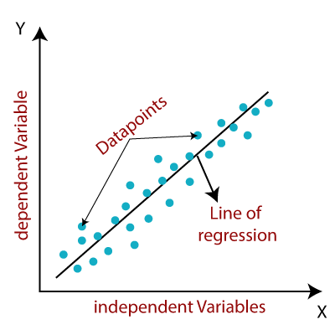
ALGORITHM : LINEAR REGRESSION
linear regression is a statistical test applied to a set of data to define and quantify the relationship between the variables considered.
Linear Regression is a machine learning algorithm which uses a dependent variable to predict future outcomes based on one or more independent variables.
It measures the association between two variables
Linear regression analysis is the most widely used of all machine learning algorithms.

Slide 6
WORKING OF LINEAR REGRESSON:
Y=A0+A1X+E
Y=Dependent Variable (Target Variable)
X= Independent Variable (predictor Variable)
A0= intercept of the line (Gives an additional degree of freedom)
A1 = Linear regression coefficient (scale factor to each input value)
E = random error
The values for X and Y variables are training datasets for Linear Regression model representation.

Slide 7
LINEAR REGRESSION
Description: It helps to analyze the strength of the association between the result (dependent variable) and the predictor variables.
Adjustment: It adjusts the effect of covariates or confounders.
Predictors: It helps to estimate the important risk factors that affect the dependent variable.
The extent of the prediction: It helps analyze the magnitude of the change in the independent variable of a “unit” that would affect the dependent variable
Prediction: It helps quantify new cases.

Slide 8
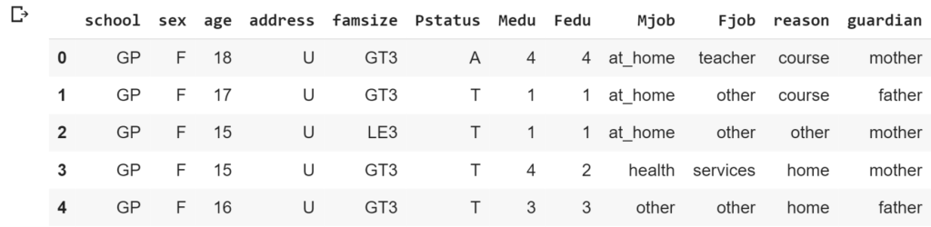
IMPLEMENTATION
I will start this task by importing the necessary Python libraries and the dataset:
DATASET :The dataset that I am using for the task of students grade prediction is based on the achievements of the students of the Portuguese schools.

Slide 9
LIBRARIES USED:
Pandas: Pandas is an open-source, BSD-licensed Python library providing high-performance, easy-to-use data structures and data analysis tools for the Python programming language.
NumPy: NumPy is a library that helps us handle large and multidimensional arrays and matrices. It provides a large collection of powerful methods to do multiple operations.
Sklearn: it provides a wide variety of tools to perform statistical modelling.

Slide 10
accuracy
I first selected the necessary columns that we need to train a machine learning model for the task of student grades prediction.
Then I declared that the G3 column is our target label and then I split the dataset into 20% testing and 80% training.
The linear regression model gave an accuracy of about 84%
0.843287677479776
Linear regression=linearRegression()
Linear_regression.fit(xtrain,ytrian)
accuracy=linear_regression.score(xtrain,ytrian)
print(accuracy)

Slide 11
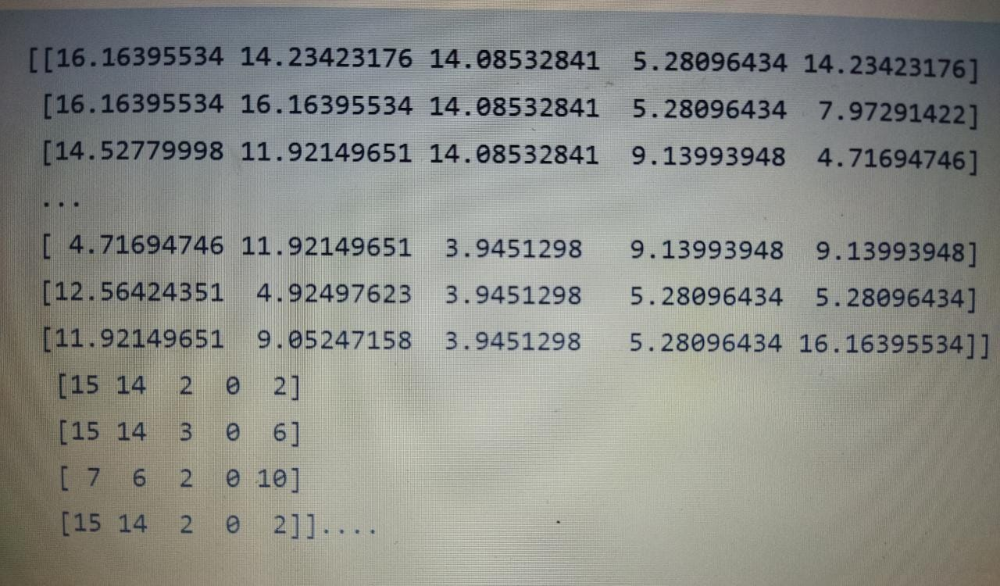
The predictions made by the students’ grade prediction model:
Predictions=linear_regression.predict(xtest)
for i in range(len(prediction)) :
print(predictions[x],xtest[x],[ytest[x]])

Slide 12
Summary
So this is how you can train a linear regression model for the task of students grade prediction with machine learning using Python.

Slide 13


